Slide 1
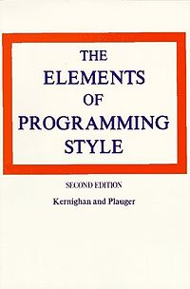
Elements of Programming Style
1974
Doesn’t describe how to write programs
Describes how to write efficient programs that can be read by computers and people
Why is it important that people can read your code?

Slide 2
Programming Style
Why is it important that people can read your code? (SURF)
Sustainable
New version of Python (4.X)
Understandable
Is it doing what you claim?
Reusable
Can it be incorporated into a larger project?
Fixable

Slide 3
Style
It doesn’t change how the code works
It makes the code a lot more approachable for the next person

Slide 4
Python Style
There isn’t only one ‘style’
Most common: PEP8
Python Enhancement Proposal #8
https://www.python.org/dev/peps/pep-0008/
Google Python Style Guide
Python is the main dynamic language used at Google. This style guide is a list of dos and don’ts for Python programs.
“More complete” PEP8
https://google.github.io/styleguide/pyguide.html

Slide 5
Put some color in your style
Tools for checking the style adherence
Many editors allow you to color your code
Sublime, Atom, vim, Visual Studio Code
Turn this ON if it isn’t already!

Slide 6
No, sorry! Those colors just don’t work together.
Play with the colors a bit…
What does your brain do when you see something like below?

Slide 7
No, sorry! Those colors just don’t work together.
Play with the colors a bit…
Your colors should never be set so that code comments are “diminished in value”
No one values my code comments.
I’m sad.

Slide 8
PEP8
Indentation
Python uses “whitespace” in its syntax
Four spaces
Most editors can be set to convert a tab that you type to four spaces in the file
What about lines that wrap? Two options…
Wrap and indent to opening of parens
Hanging indent (put nothing after parens and indent only once)

Slide 9
PEP8
Indentation

Slide 10
PEP8
Indentation

Slide 11
PEP8
Indentation

Slide 12
PEP8
Indentation
Equivalent, no specific recommendation

Slide 13
PEP8
Maximum line length?
Coding lines? Keep it to 79 characters
Most editors can show you the line position
E.g. vim, Sublime
Comments & doc strings?
72 characters
Why? My monitor is big!
Open two files side by side? History?
Some teams choose to use a different max
Python core library is 79/72

Slide 14
PEP8
Line spacing
Two blank lines around top-level functions
Two blank lines around classes
One blank line between functions in a class
One blank line between logical groups in a function (sparingly)
Extra blank lines between groups of groups of related functions (why are they in the same file?)

Slide 15
PEP8
Line spacing
Two blank lines around top-level functions
Two blank lines around classes
One blank line between functions in a class
One blank line between logical groups in a function (sparingly)
Extra blank lines between groups of groups of related functions (why are they in the same file?)

Slide 16
PEP8
Imports
Imports go at the top of a file after any comments
Imports for separate libraries go on separate lines

Slide 17
PEP8
Imports
Imports go at the top of a file after any comments
Imports for separate libraries go on separate lines

Slide 18
PEP8
Imports
Imports should be grouped with a blank line separating each group in the following order:
Standard library imports
os, sys, …
Related third party imports
matplotlib, seaborn, numpy, etc...
Local application / library specific imports
knn_utils

Slide 19
PEP8
Imports
Avoid wildcard imports
Be explicit about namespaces when necessary

Slide 20
PEP8
Quotes
When should I use single?
When should I use double?

Slide 21
PEP8
Quotes
PEP8 has no recommendation about single vs. double
Except for triple quotes strings, use double
Multiline strings, docstrings, etc.

Slide 22
PEP8
Whitespace
No trailing spaces at end of a line
Do not pad ( [ { with spaces, e.g.
Do not pad before : ; , , e.g.
What else is wrong with the above?

Slide 23
PEP8
Whitespace
Always surround =, +=, -=, == , < , > , != , <> , <= , >= , in , not in , is , is not, and, or, not with a single space
Having fun yet?

Slide 24
PEP8
Whitespace
Never surround = with a space as a function parameter argument
Really having fun yet?

Slide 25
PEP8
Compound statements

Slide 26
Remember this mess?

Slide 27
Tools for style checking
Tools for checking the style adherence
Simplest is pycodestyle
Formerly known as pep8
conda install pycodestyle
Also see flake8
As above with additional code checks, e.g. are imports made or variables defined that aren’t used
conda install flake8
Is basically a wrapper to pycodestyle

Slide 28
Checking yourself out in the mirror
Another tool and the one to use for HW4
pylint ( http://www.pylint.org )
Extends from a tool called lint introduced for C from Bell Labs in 1976
http://citeseerx.ist.psu.edu/viewdoc/summary?doi=10.1.1.56.1841
conda install pylint

Slide 29
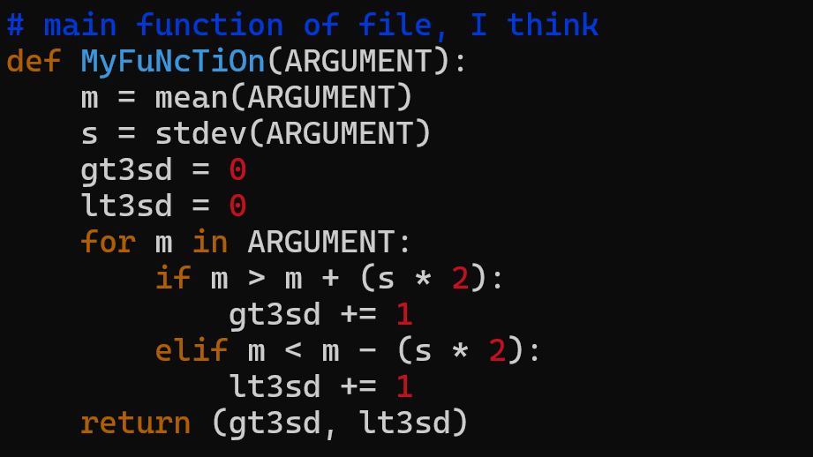
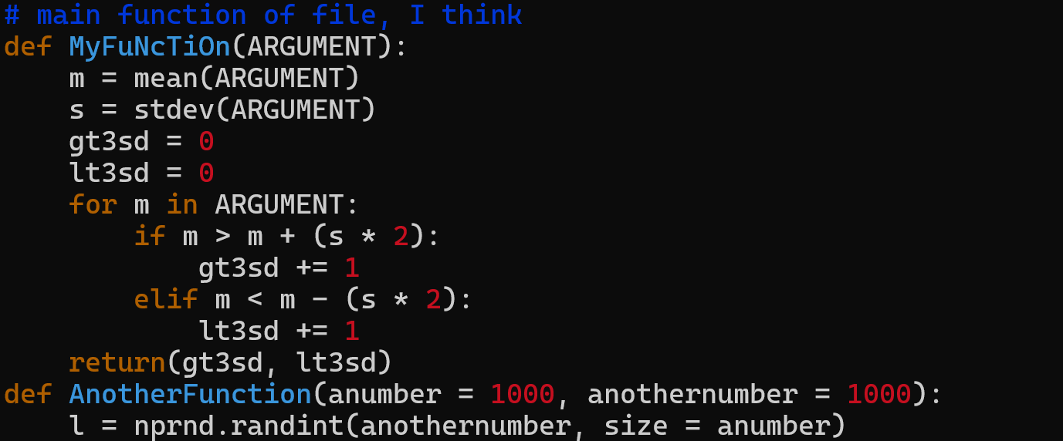
Checking yourself out in the mirror
An additional tool I’m kind of meh on for learners
black ( https://black.readthedocs.io/en/stable/ )
Black is a “pretty printer” or “formatter”
conda install black
After
Before

Slide 30
Getting’ some style
How to use them? Replace pylint with tool…
pylint <filename.py>
e.g. python_demo_1.py
pylint <directory with .py files>
e.g. python mypackage

Slide 31
Ask a friend?
Other ways to check your style:
Many editors support real time style checking!
Visual Studio Code (DEMO)
Atom (discontinued)
Most default Jupyter notebook setups do not offer style checking
Know and use style until it becomes muscle memory!
Ask a friend

Slide 32
Let’s play!
Curl down the example file from the syllabus
Try each tool, skipping pycodestyle for now
flake8 python_demo_1.py
Look at the errors / warnings….
pylint python_demo_1.py
Use your editor to fix the errors using pylint as your guide. Try to get above 8/10.

Slide 33
Let’s play!
Curl down the example file from the syllabus python_demo_2.py
Now run black on the file, e.g.
black python_demo_2.py
Compare the two files, e.g.
diff python_demo_1.py python_demo_2.py

Slide 34
This slide intentionally left blank

Slide 35
Elements of Programming Style
Choose variable names that won’t be confused.

Slide 36
PEP8
Naming conventions
How you name functions, classes, and variables can have a huge impact on readability

Slide 37
PEP8
Naming conventions
Avoid the following variable names:
Lower case L (l)
Upper case O (O)
Upper case I (I)
There are unacceptable, terrible, and awful. Why?
Can be confused with 1 and 0 in some fonts
Can be confused with each other (i.e. I and l)

Slide 38
PEP8
Naming conventions
Module names should be short, lowercase
Underscores are OK if it helps with readability
Package names should be short, lowercase
Underscores are frowned upon and people will speak disparagingly behind your back if you use them

Slide 39
PEP8
Naming conventions
Class names should be in CapWords
SoNamedBecauseItUsesCapsForFirstLetterInEachWord
Also known as CamelCase
Notice no underscore!
Much hate on the internet for
Camel_Case

Slide 40
PEP8
Naming conventions
What naming convention should I use for exceptions?
WHY?

Slide 41
PEP8
Naming conventions
Functions
Lowercase, with words separated by underscores as necessary to improve readability
mixedCase is permitted if that is the prevailing style (some legacy pieces of Python used this style)
Easy habit to fall into… Very common in style guides for other languages, e.g. R
If this is your thing, then be consistent

Slide 42
PEP8
Why be consistent from day 1?
https://goo.gl/o57K7g

Slide 43
PEP8
Naming conventions
Functions

Slide 44
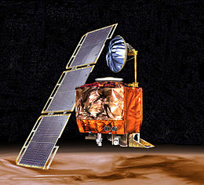
Programming Style
Functions
Where units matter, append them…
Variable names also
Things go wrong…
Mars Climate Orbiter
… on September 23, 1999, communication with the spacecraft was lost as the spacecraft went into orbital insertion, due to ground-based computer software which produced output in non-SI units of pound-seconds (lbf×s) instead of the metric units of newton-seconds (N×s) specified in the contract between NASA and Lockheed.
- Wikipedia
655.2 million dollar mistake!

Slide 45
PEP8
Naming conventions
Global variables
These shouldn’t be truly global, just global to a module’s namespace
Function variables
Function / method arguments
All the above use lower case with words separated by underscores

Slide 46
PEP8
Naming conventions
Constants
What is a constant?
Some examples of where you might use constants?
Python has no specific capability for making a variable constant; all variables are reassignable
To indicate a variable is a constant, use all CAPS, e.g.
6.0221409e+23 6.67408 × 10⁻¹¹ m³ kg⁻¹ s⁻²

Slide 47
PEP8
Naming conventions
Constants
Remember this ugly mess? What could be a constant?

Slide 48
PEP8
Naming conventions
When naming functions and variables…
Be consistent about pluralization / type Ids
Which do you prefer and why?
Given your choise for the above, what would I name a variable that contained a collection of times? Users?

Slide 49
PEP8
There is a lot more detail in the PEP8 spec (on the syllabus)… E.g. Why is this not only bad style but potentially buggy?

Slide 50
PEP8
Correct version

Slide 51
PEP8
Programming Recommendations
This section is highly recommended
https://www.python.org/dev/peps/pep-0008/#id46
E.g. Use ''.startswith() and ''.endswith() instead of string slicing to check for prefixes or suffixes.
E.g. For sequences, (strings, lists, tuples), use the fact that empty sequences are false.

Slide 52
PEP8

Slide 53
PEP8
Consistency

Slide 54
Documentation
Two types
Code readers
What the code is doing and why
E.g.
Users
How to use your code
E.g.
Code comments
README.md

Slide 55
Documentation
.md
.md files are Markdown
Markdown is a lightweight text formatting language for producing mildly styled text
Ubiquitous (github.io, README.md, etc.)
E.g. Google markdown editor browser
http://dillinger.io

Slide 56
Documentation
Good comments
Make the comments easy to read
Write the comments in English
Discuss the function parameters and results

Slide 57
Documentation
Good comments
Don’t comment bad code, rewrite it!
Then comment it

Slide 58
Documentation
Good comments
Some languages have special function headers

Slide 59
Documentation / PEP8
Good comments
Inline comments
Comments inline with the code
Generally unnecessary (as above)
Inhibit readability

Slide 60
Documentation
Good comments
Wrong comments are bugs
When updating code, don’t forget to update the comments

Slide 61
Documentation
Good comments
Don’t insult the reader
If they are reading your code… they aren’t that dumb
Corollary: don’t comment every line!

Slide 62
Documentation
Good comments
Don’t comment every line!

Slide 63
Documentation / PEP8
Good comments
Comments should be sentences. They should end with a period. There should be a space between the # and the first word of a comment.
You should use two spaces after a sentence-ending period. (Easy for those of a certain age)

Slide 64
Documentation / PEP 0257
Docstrings
String literal as the first statement in
Modules
Functions
Classes
https://www.python.org/dev/peps/pep-0257/

Slide 65
Documentation / PEP 0257
Docstrings
They are triple quoted strings
What kind of quotes to use?
They can be processed by the docutils package into HTML, LaTeX, etc. for high quality code documentation (that makes you look smart).
They should be phrases (end in period).

Slide 66
Documentation / PEP 0257
Docstrings
Multiline docstrings are more of the norm

Slide 67
Documentation / PEP 0257
Docstrings
For scripts intended to be called from the command line, the docstring at the top of the file should be a usage message for the script.

Slide 68
Documentation / PEP 0257
Docstrings
For modules and packages, list the classes, exceptions and functions (and any other objects) that are exported by the module, with a one-line summary of each.
Looking at scikit learn and seaborn (as examples) this didn’t seem to be the norm. However,
https://github.com/numpy/numpy/blob/master/numpy/__init__.py

Slide 69
Documentation / PEP 0257
Docstrings
Most importantly… For functions and methods, it should summarize its behavior and document its arguments, return value(s), side effects, exceptions raised.
Example from scikit learn:
https://github.com/scikit-learn/scikit-learn/blob/master/sklearn/cluster/dbscan_.py

Slide 70
Homework 4, in class
Clone your homework 3 submission
Copy the *.py (only these files) to the hw4 submission
Write doc strings at the top of each .py file (module docstrings)
Write doc strings at the top of each function (function docstrings)
Get a pylint score > 8.0 (and save it)

